Slide 2

Program the Rainbow
Working with Colors in Delphi
Slides and samples
github.com/jimmckeeth/Programming-the-Rainbow

Slide 3


Jim McKeeth
GDK Software
Embarcadero Delphi MVP
Director of Consulting
jim@gdksoftware.com
gdksoftware.com

Slide 4
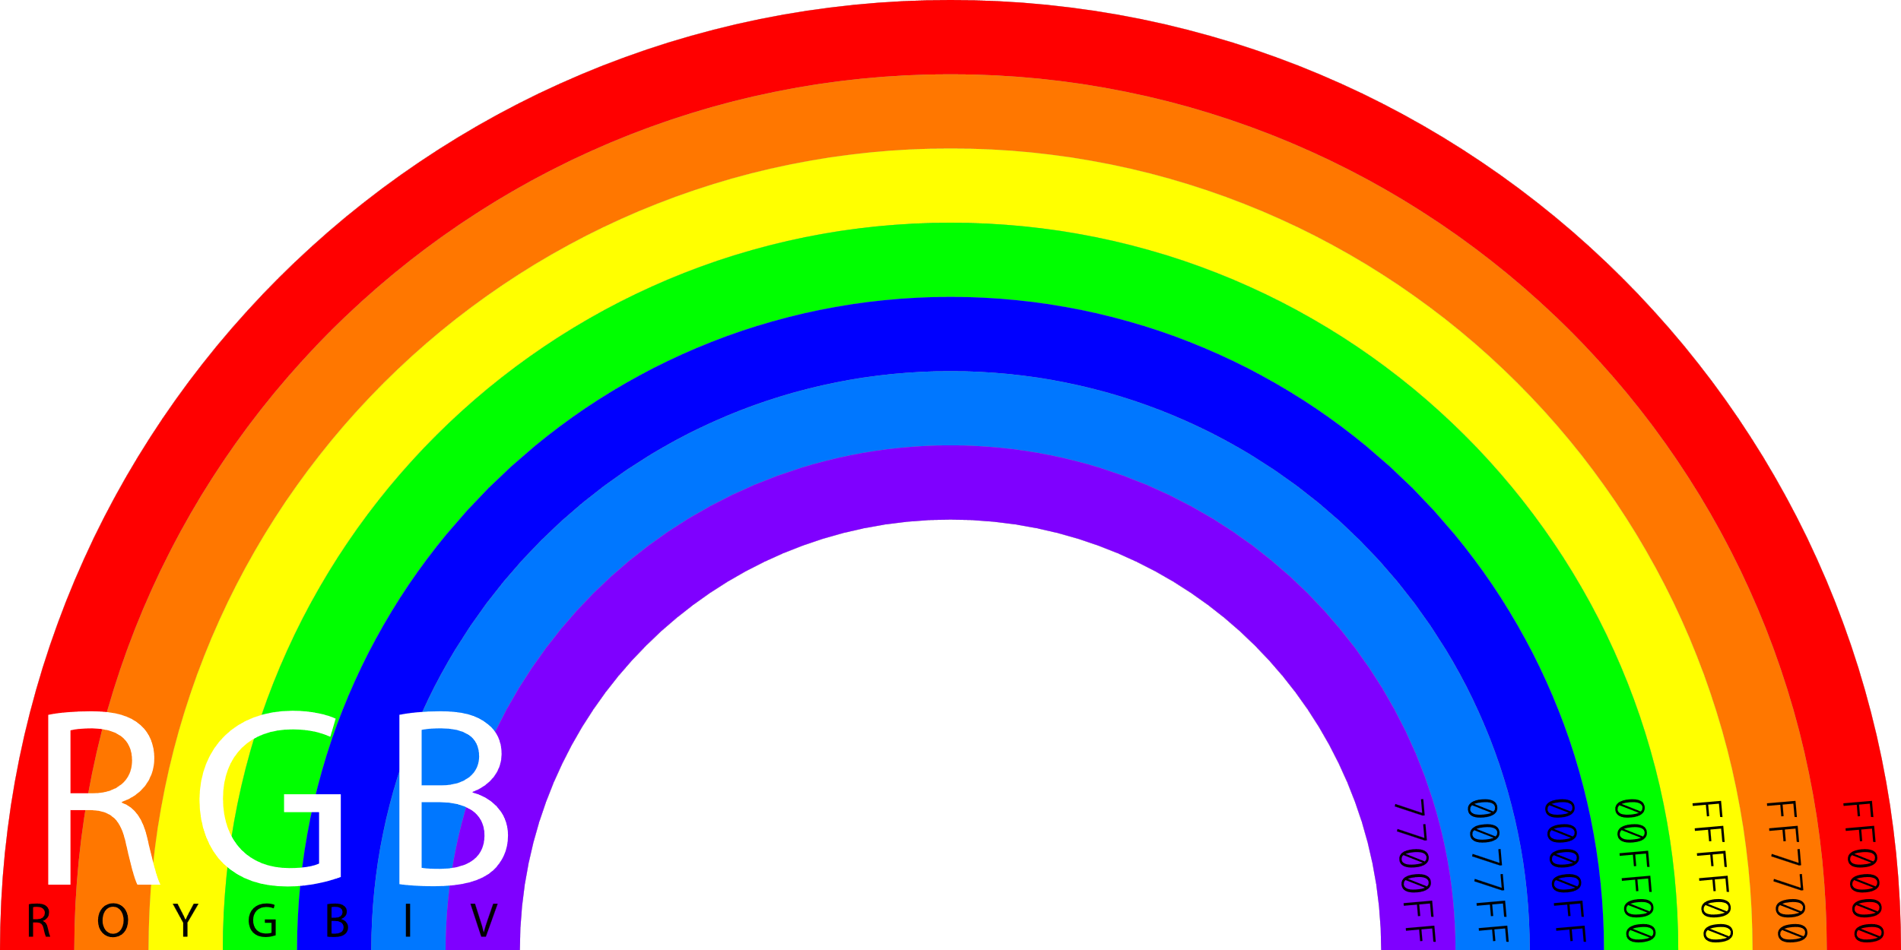
INTERFACE
Color theory
TAlphaColor vs TColor
RGB, HSL, & CMYK
Complementary colors
Palettes & Blending
Gradients, shades, tints, tones
Color names
Slides and samples
github.com/jimmckeeth/Programming-the-Rainbow

Slide 5
Program the Rainbow: Working with Colors Explore the fundamentals of color theory and how to effectively work with colors in Delphi. Understand the distinctions between TColor and TAlphaColor, and learn to convert between RGB, CMYK, and HSL color models. Discover how to generate complementary colors and build cohesive palettes, enabling you to craft vibrant, visually appealing applications. Delve into the various color-related components available in VCL and FireMonkey, and learn techniques for creating gradients, shades, tints, tones, and blending colors seamlessly. We'll also look at the powerful new features Skia offers for working with colors and advanced color spaces. Get ready to program a rainbow and bring your UI to life!

Slide 6
IMPLEMENTATION

Slide 7
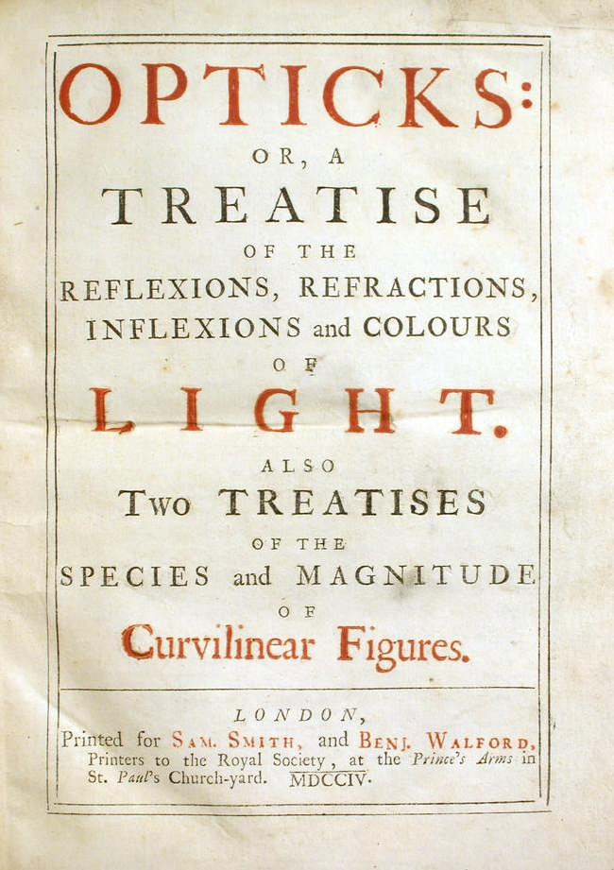
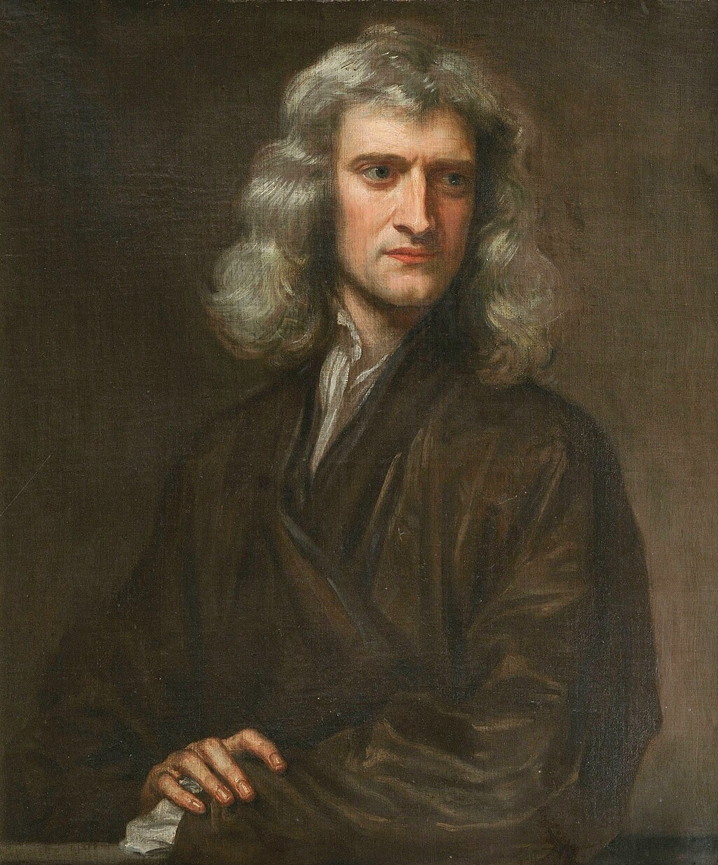
Early Color Theory
322 BCE: Early musings on color in Aristotle's On Colors
1800s: formalized "color theory" with Isaac Newton’s Opticks

Slide 8
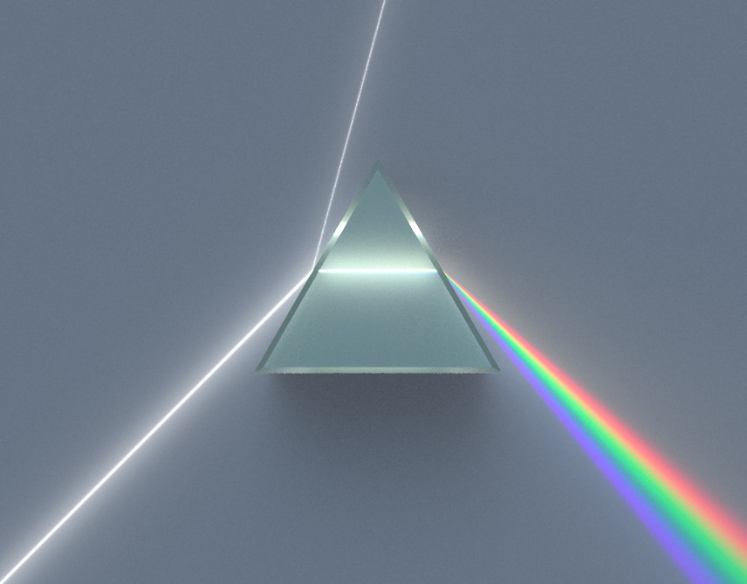
Visible Light
Newton showed a prism separates white sunlight into the visible spectrum
https://commons.wikimedia.org/wiki/File:Dispersive_Prism_Illustration.jpg by Cepheiden, CC BY-SA 3.0

Slide 9
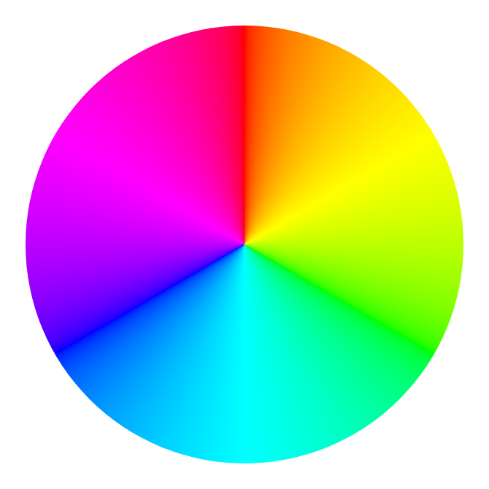
Color Wheel
Illustrative organization of color hues around a circle (360°)
Shows the relationships of colors
0° and 360° are red
Gradient RGB/CMY color wheel

Slide 10
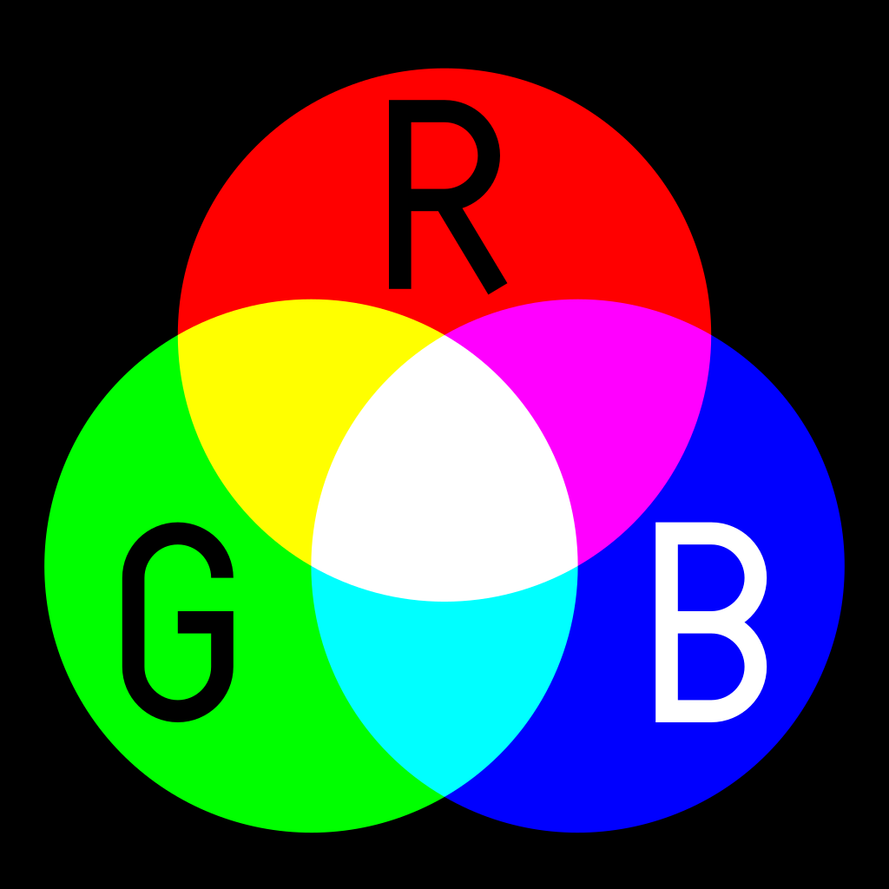
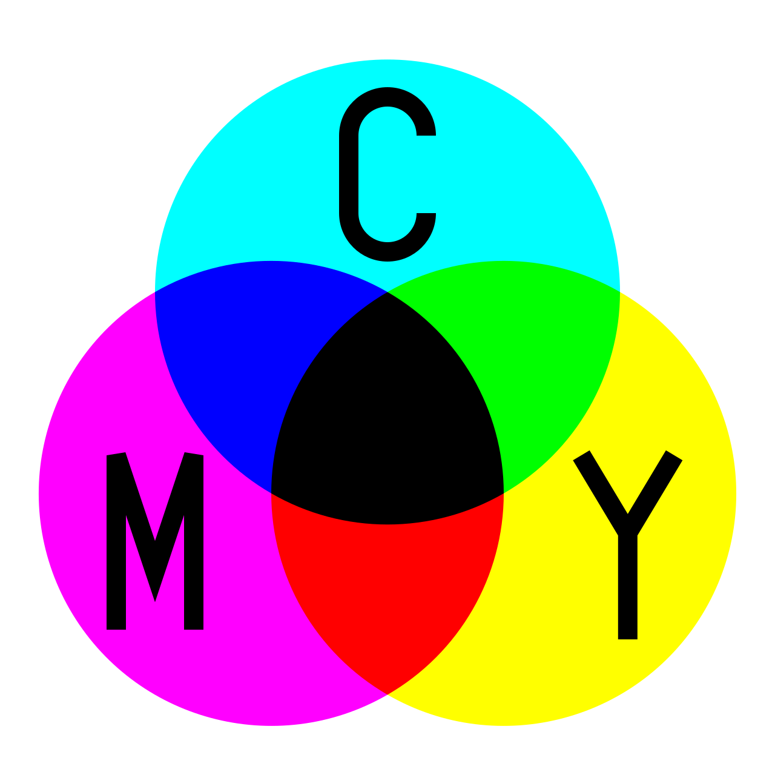
Primary Colors
Additive primary colors
Red, Green, Blue (RGB)
When mixing light
All three create white
Subtractive primary colors
Cyan, Magenta, & Yellow (CMY)
When mixing pigments on white
All three create black

Slide 11
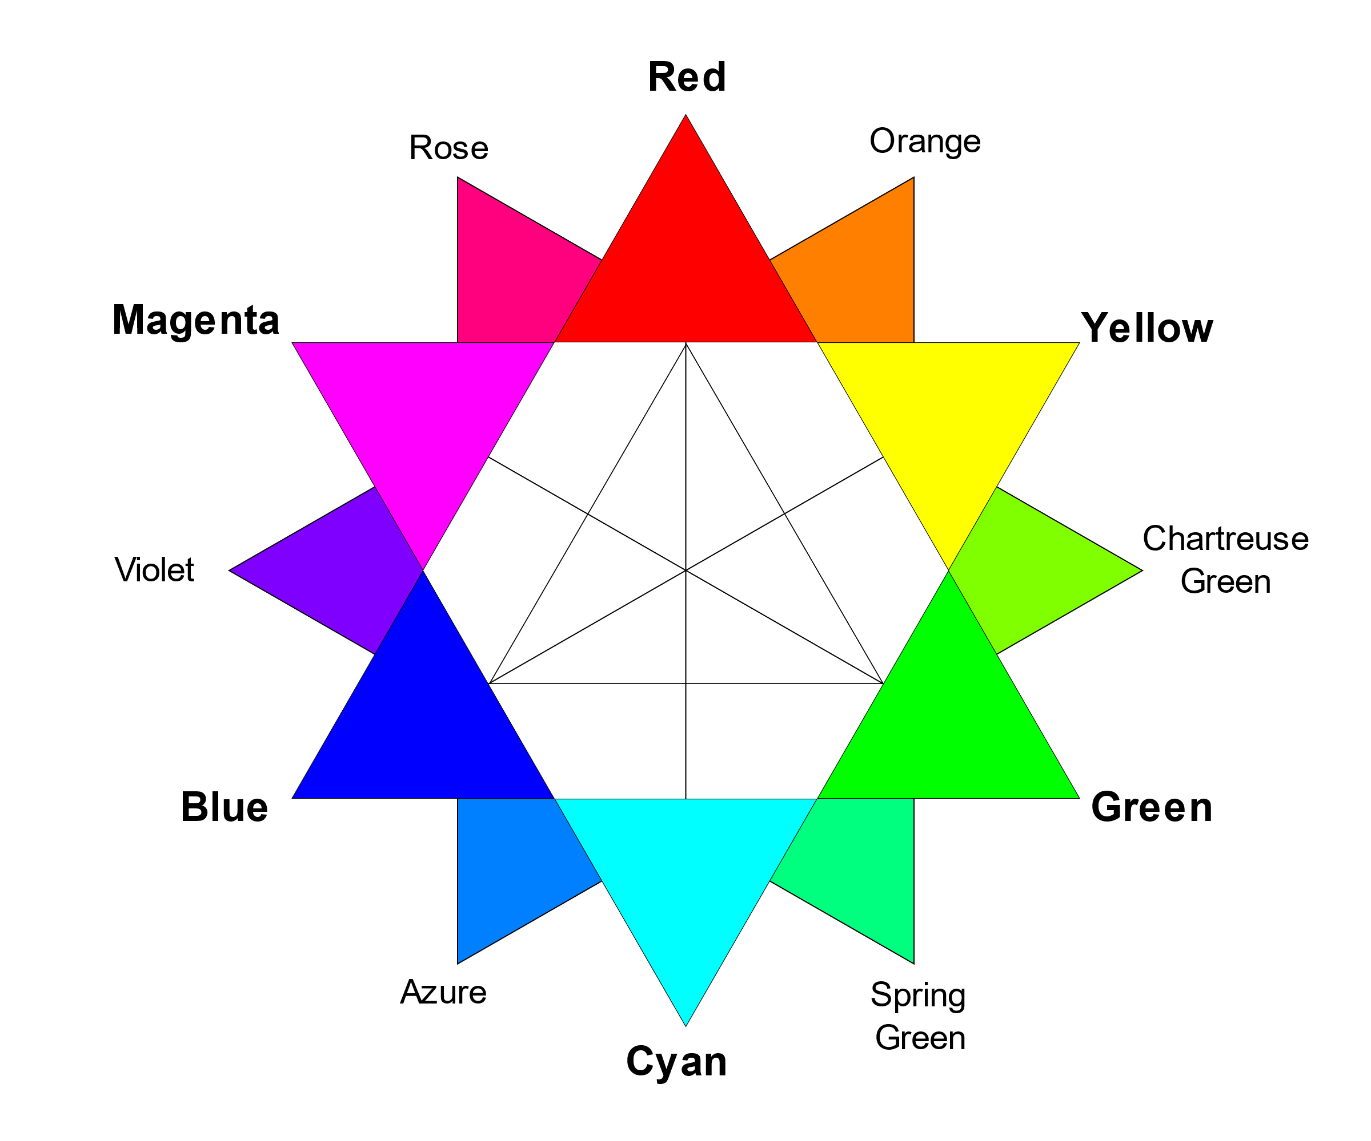
Color Science
Scientific study of color: lighting; optics; measurement; physiology; psychophysics; modeling of color vision; and color reproduction
The modern evolution of Color Theory
https://en.wikipedia.org/wiki/Color_theory
https://en.wikipedia.org/wiki/Color_science
By DanPMK at English Wikipedia, CC BY-SA 3.0, https://commons.wikimedia.org/w/index.php?curid=13427725

Slide 12
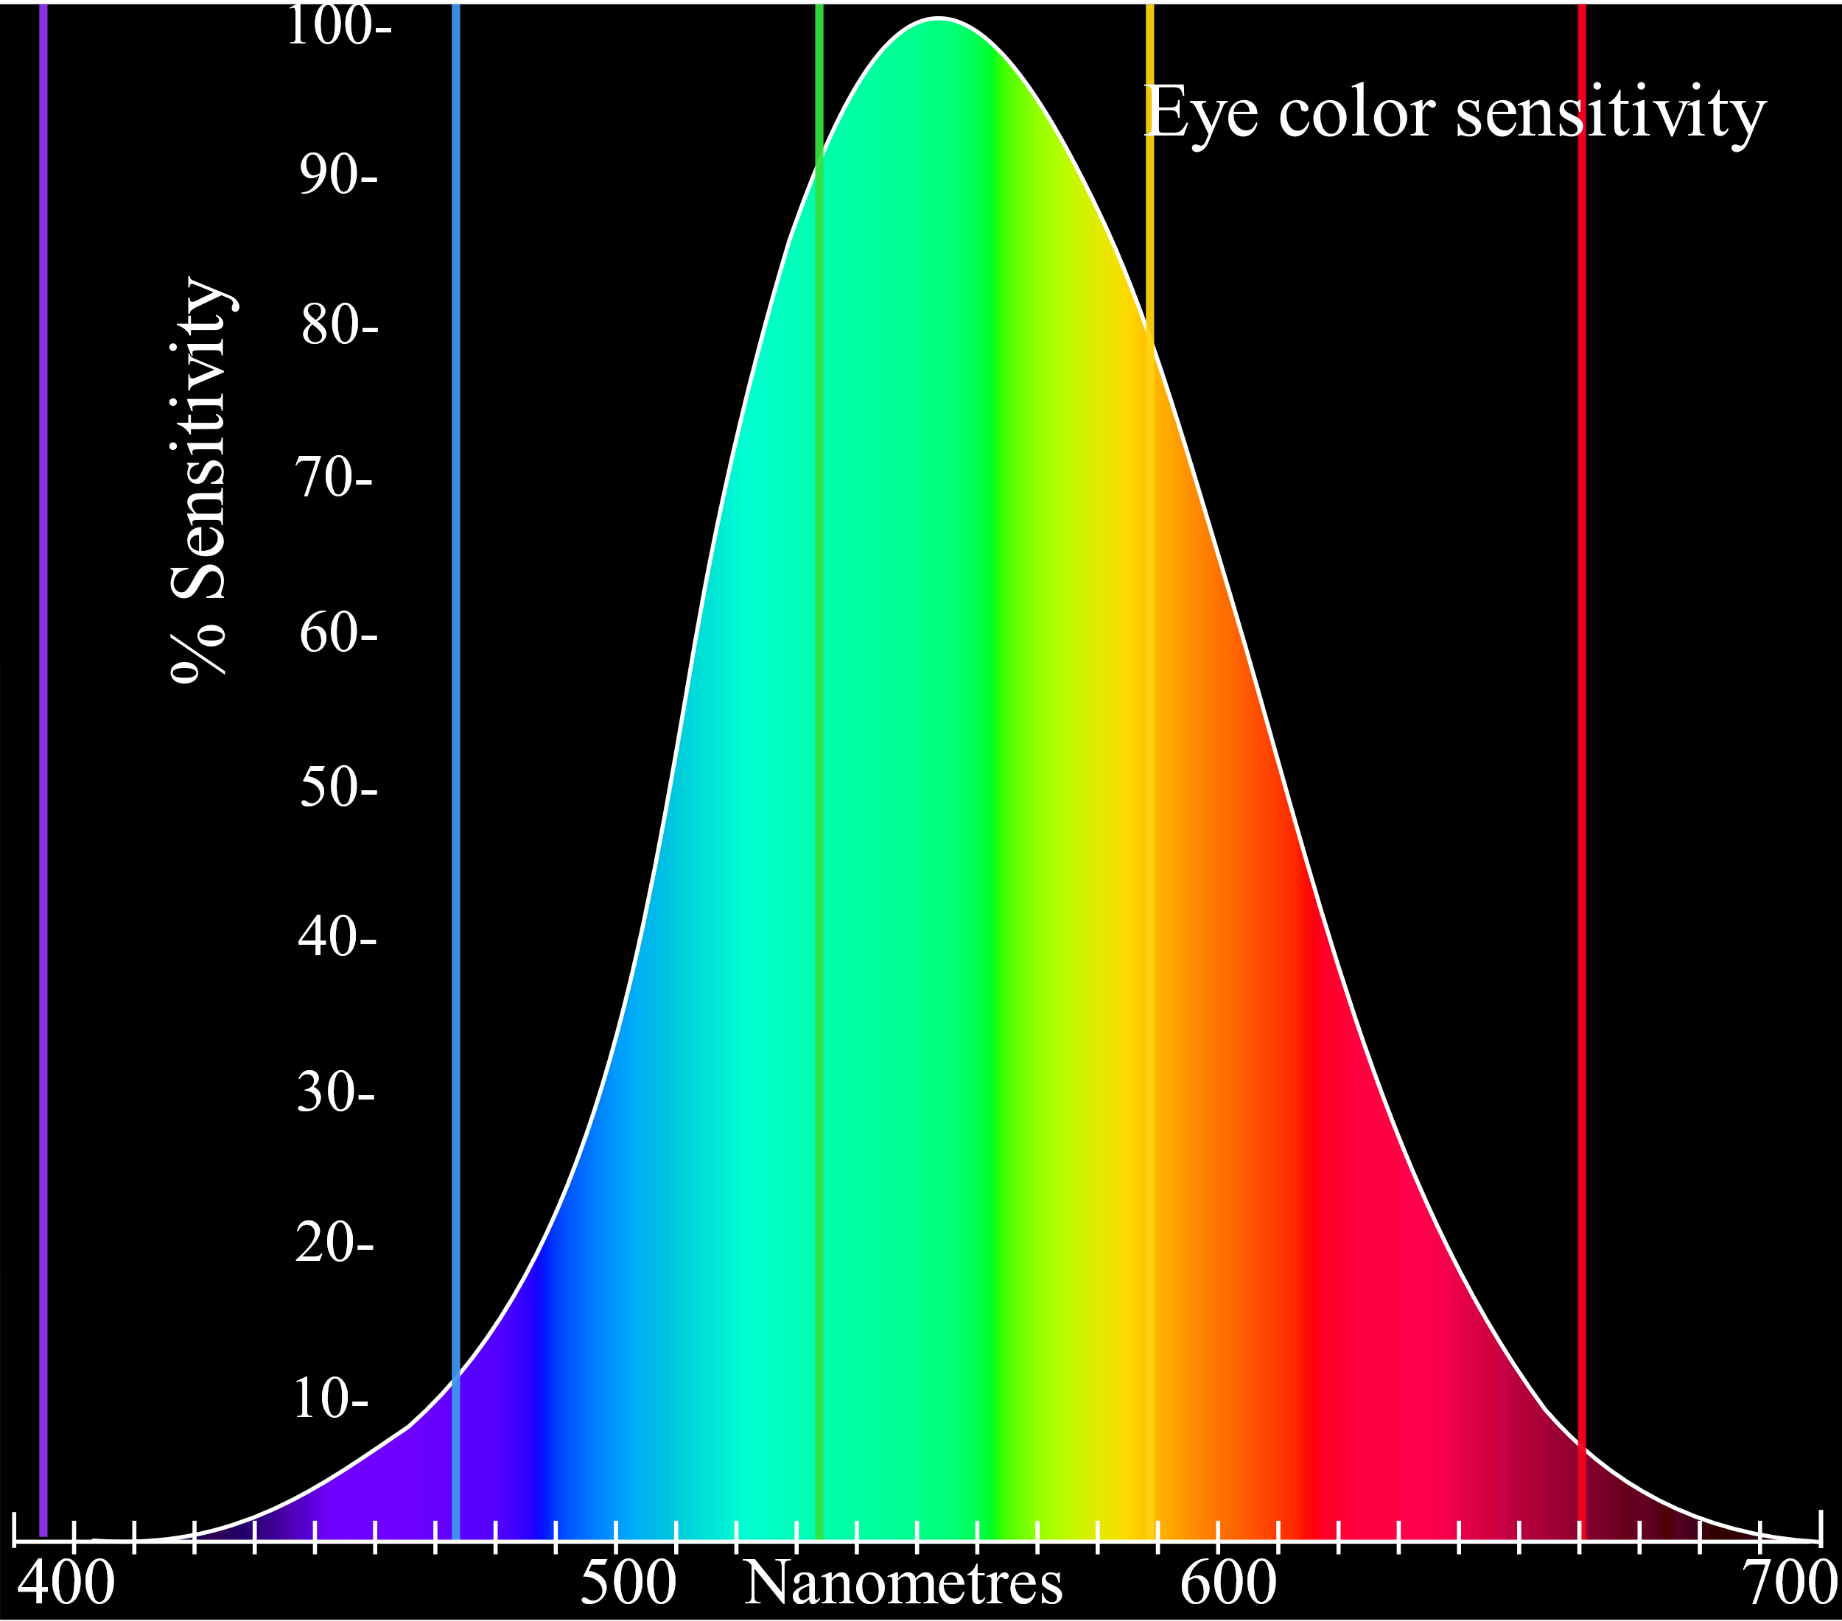
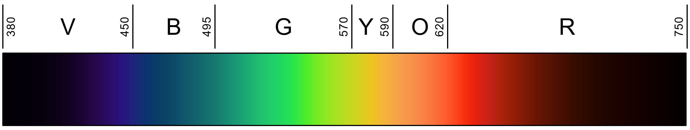
Human Color Vision Sensitivity
Relative brightness sensitivity as a function of wavelength →
A linear representation of the visible light spectrum ↓
By Skatebiker, vector by Adam Rędzikowski - File:Evesensitivity.svg, vectorised, CC BY-SA 3.0, https://commons.wikimedia.org/w/index.php?curid=24492291

Slide 13
BEGIN Show me the code!

Slide 14
TColor vs TAlphaColor = Incompatible
See more in
QP Issue
RSS-1432
unit System.UITypes;
TColor = -$7FFFFFFF-1..$7FFFFFFF;
TColorRec = record
// TColor constants
class var ColorToRGB:
function (Color: TColor): Longint;
case Cardinal of
0: (Color: TColor);
2: (HiWord, LoWord: Word);
3: (R, G, B, A: System.Byte);
end;
TAlphaColor = type Cardinal;
TAlphaColorRec = record
// TAlphaColor constants
class var ColorToRGB:
function (Color: TAlphaColor): Longint;
case Cardinal of
0: (Color: TAlphaColor);
2: (HiWord, LoWord: Word);
3: (B, G, R, A: System.Byte);
end;
TColor is an integer (+ & -) subrange, while TAlphaColor is a full cardinal (+ only).
TColor orders the bytes R, G, B, A and TAlphaColor orders them B, G, R, A
They are incompatible, but the compiler implicitly converts them

Slide 15
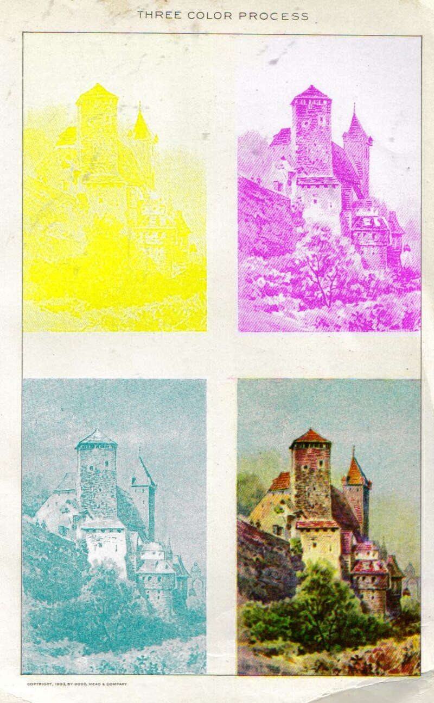
Working with CMYK
Cyan, Magenta, Yellow & Black (or Key)
The subtractive primary colors
CMYK, by its nature, is not native for a display screen
Converting an approximation and frequently makes use of color management systems (color space or color profile).

Slide 16

RGBToCMYK
uses System.Math;
// Handle black manually
var r := 1 - (Red / 255);
var g := 1 - (Green / 255);
var b := 1 - (Blue / 255);
var k := Min(r, Min(g, b));
Cyan := (r - k) / (1 - k);
Magenta := (g - k) / (1 - k);
Yellow := (b - k) / (1 - k);
Key := k;

Slide 17
CMYKtoRGB
Going back is relatively easy
Red := Round(255 * (1-Cyan) * (1-Key));
Green := Round(255 * (1-Magenta) * (1-Key));
Blue := Round(255 * (1-Yellow) * (1-Key));

Slide 18
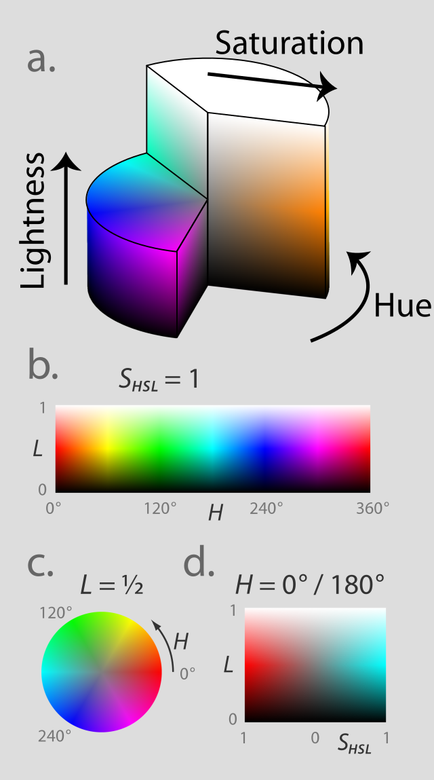
HSL
Each is a Single with a range of 0 to 1
Hue is the color in 0° to 360°
Saturation is amount of color
0% = Grey; 100% = Pure color
Lightness
0% = White
50% = Pure color
100% = Black
https://en.wikipedia.org/wiki/HSL_and_HSV
By Jacob Rus - Own work, CC BY-SA 3.0
https://commons.wikimedia.org/w/index.php?curid=9445469

Slide 19
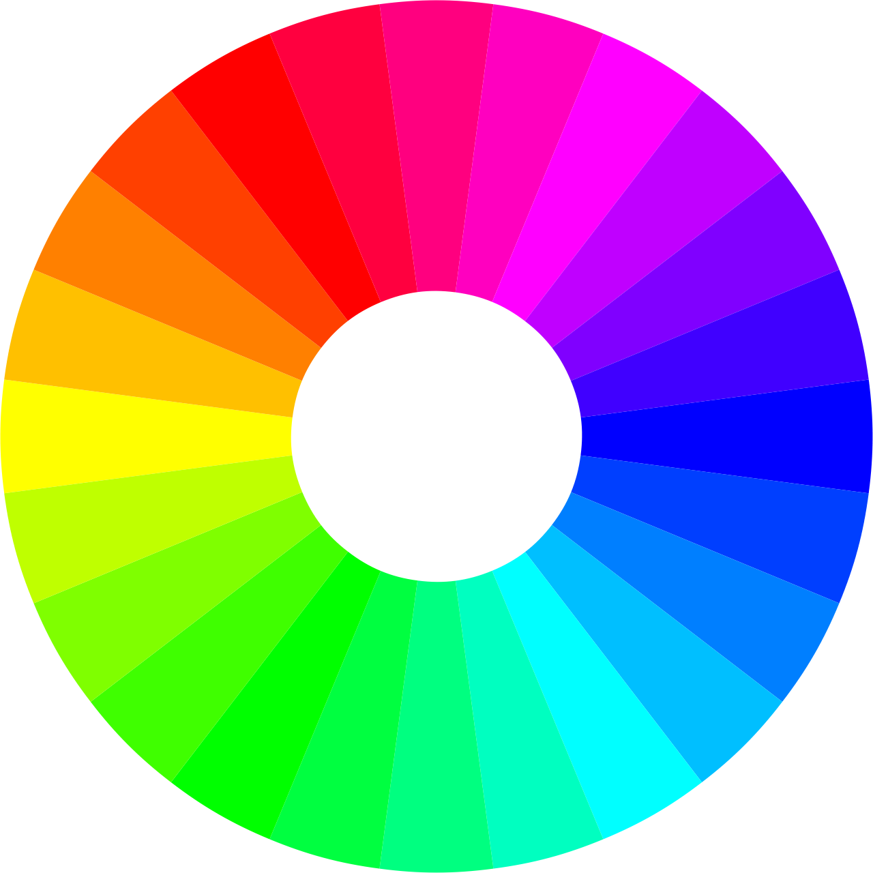
Working with HSL
unit System.UIConsts;
// Create TAlphaColor from HSL
function HSLtoRGB(H, S, L: Single): TAlphaColor;
// Convert TAlphaColor to HSL
procedure RGBtoHSL(RGB: TAlphaColor;
out H, S, L: Single);
// Changes the TAlphaColor by the HSL delta provided
function ChangeHSL(const C: TAlphaColor; dH, dS, dL: Single): TAlphaColor;

Slide 20
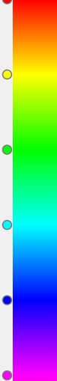
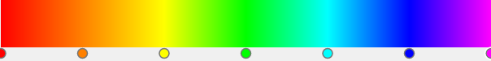
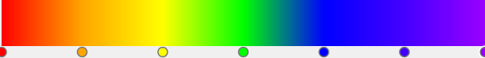
Making a Rainbow Gradient
Newton's |  |  | Modern |  |  | Hue
Color | Hex |  | Color | Hex |  | Color | Hex | Hue
Red | FF0000 |  | Red | FF0000 |  | Red | FF0000 | 0°
Orange | FFA500 |  | Orange | FF8000 |  | Yellow | FFFF00 | 60°
Yellow | FFFF00 |  | Yellow | FFFF00 |  | Green | 00FF00 | 120°
Green | 00FF00 |  | Green | 00FF00 |  | Cyan | 00FFFF | 180°
Blue | 0000FF |  | Cyan | 00FFFF |  | Blue | 0000FF | 240°
Indigo | 4400FF |  | Blue | 0000FF |  | Magenta | FF00FF | 300°
Violet | 9900FF |  | Magenta | FF00FF

Slide 21
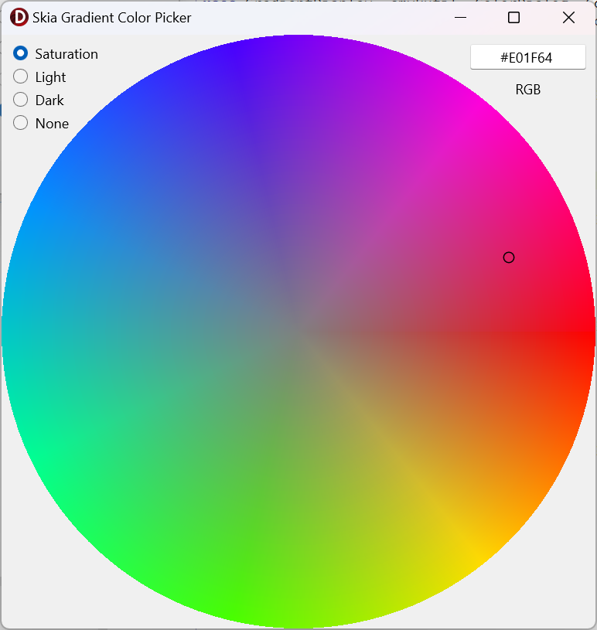
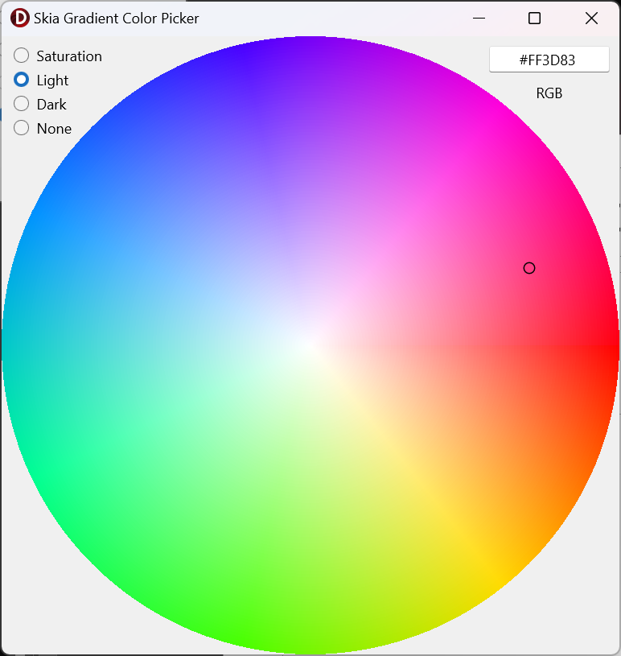
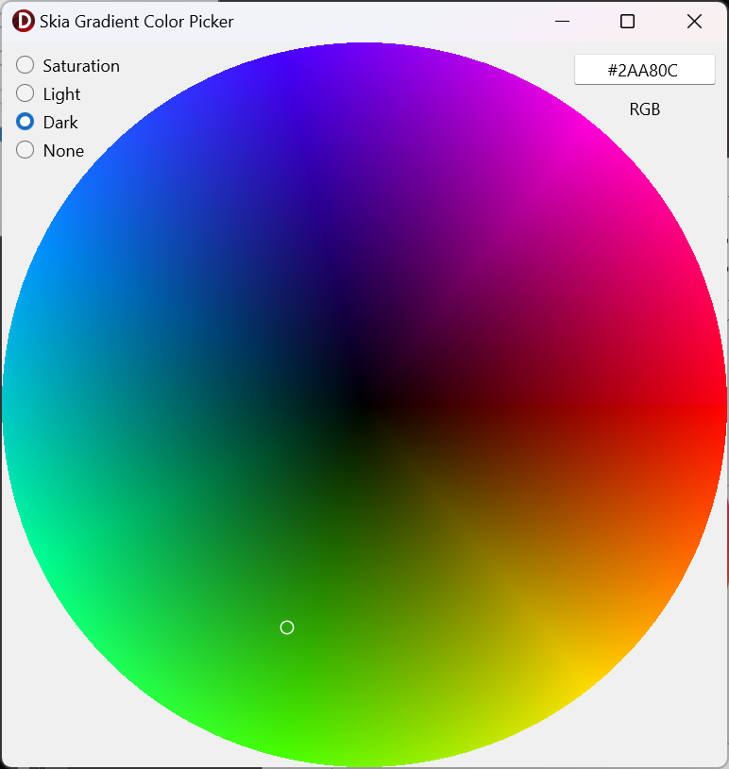
Gradient Color Picker (with Skia)

Slide 22
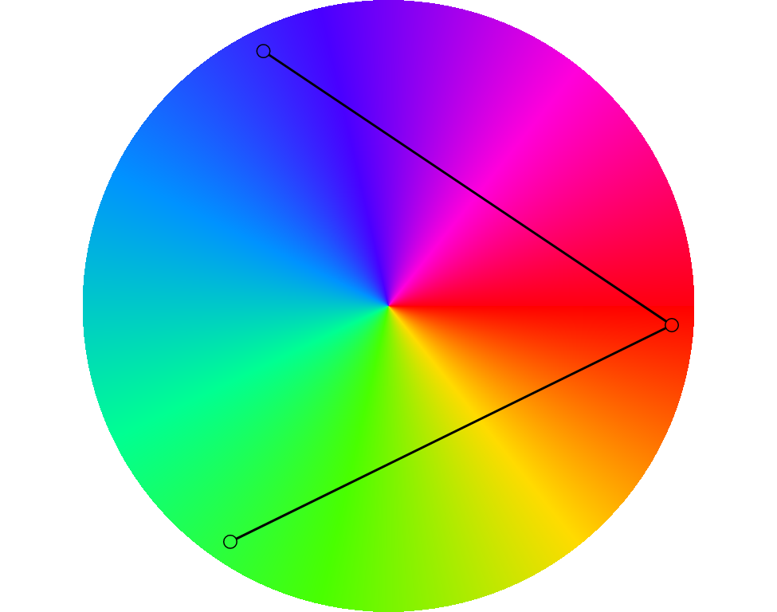
Palates & Complementary Colors
Its easy with HSL, just modify the hue
Complementary: 0°, 180°
Split-complementary: 0°, 150°, 210°
Analogous: 0°, 30°, 330°
Triadic: 0°, 120°, 240°
Tetradic: 0°, 60°, 180°, 240°
Hexadic: 0°, 60°, 120°, 180°, 240° and 300°
https://en.wikipedia.org/wiki/Color_scheme

Slide 23
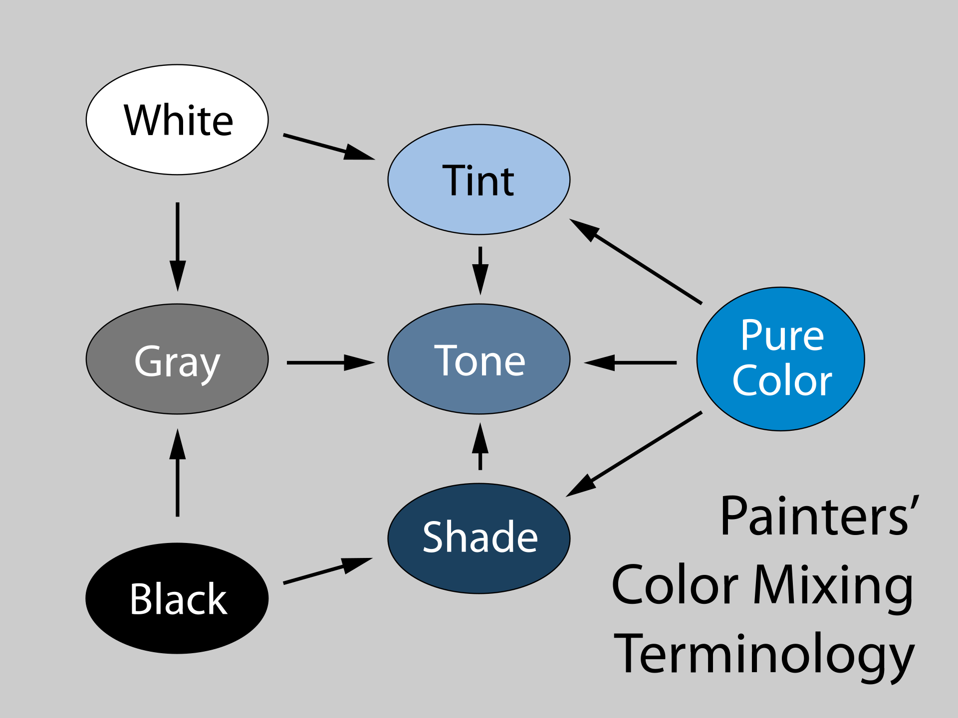
Shades, Tints, and Tones
Start with a pure color (hue)
Tint
Lightness from 1 to 0.5
Shade
Lightness from 0 to 0.5
Tone
Saturation from 0 to 1

Slide 24
FINALIZATION
Slides and samples
github.com/jimmckeeth/Programming-the-Rainbow

Slide 25
Resources
Slides
github.com/jimmckeeth/Programming-the-Rainbow
Samples (and a whole lot more)
github.com/jimmckeeth/FMXColorDialog

Slide 26
END.
Slides and samples
github.com/jimmckeeth/Programming-the-Rainbow

